Slide 1
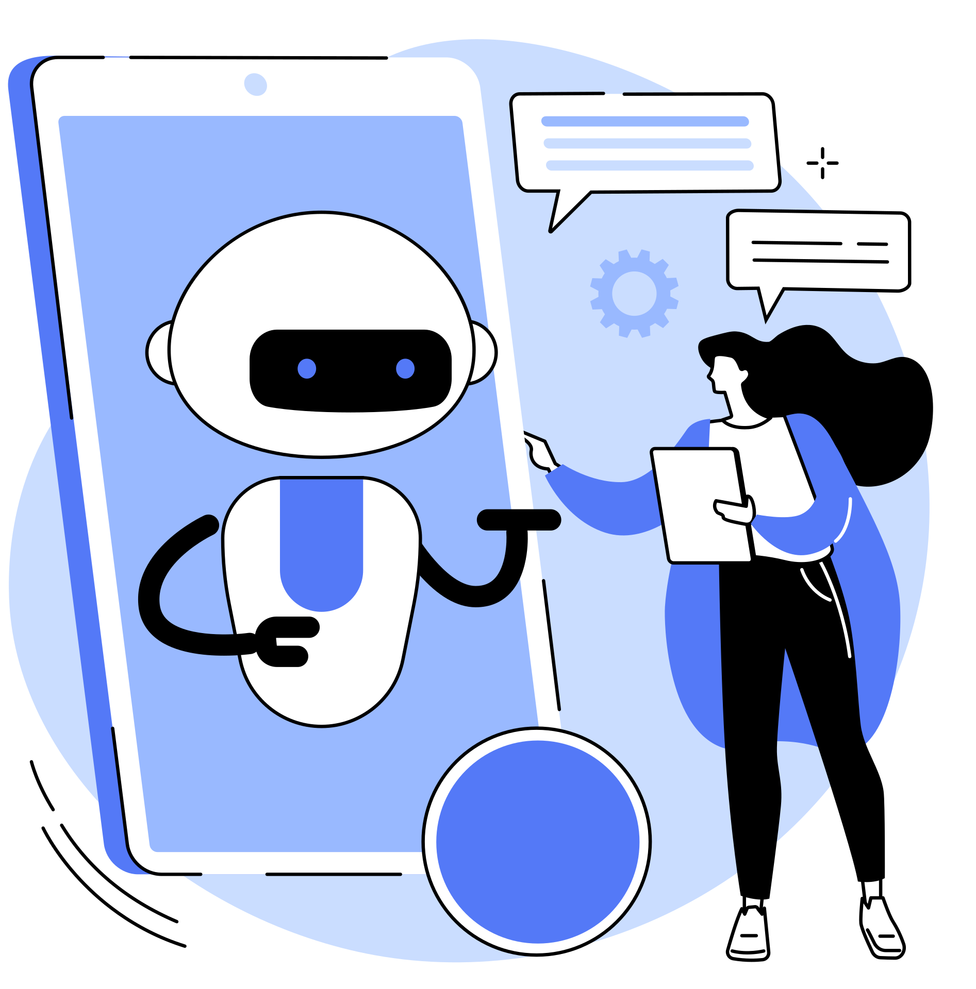
Generative AI
BY
JASMIN RUTTER, JADE MATZEL, ARYA MAZANDARANI, SHAAN MALIK

Slide 2
What is Generative AI
[INSERT]

Slide 3
Generative AI Models
[INSERT]

Slide 4
How Generative AI Works
[INSERT]

Slide 5
Applications of Generative AI
[INSERT]

Slide 6
Challenges
[INSERT]

Slide 7
Generative AI in Healthcare
[INSERT]

Slide 8
Natural Language Processing
[INSERT]

Slide 9
Case Studies
[INSERT]

Slide 10
Future Trends
[INSERT]

Slide 11
Conclusion
[INSERT]

Slide 12
References
[INSERT]

